Slide 1

NOIDA INSTITUTE OF ENGINEERING & TECHNOLOGY GREATER NOIDA
Course:- B. Tech & Branch:- CSE, DS, AI, AIML, IoT Subject Name:- Finance For Engineers and Code:-AOE0770
Lecture – (1-8) UNIT-1
By
Name of Faculty:- Ms Sonali Sharma
Designation:- Assistant Professor
Department:- MBA Department
NIET, GREATER NOIDA

Slide 2
Index
S No | Content
1 | Name of Subject with code, Course and Subject Teacher
2 | Brief Introduction of Faculty member with Photograph
3 | Evaluation Scheme
4 | Syllabus
5 | Branch wise Application
6 | Course Objective(s)
7 | Course Outcome(s)
8 | Program Outcomes (POs)
9 | COs and POs Mapping
10 | Program Educational Objectives (PEOs)
11 | Result Analysis
12 | End Semester Question paper Templates
13 | Prequisite/Recap

Slide 3
Index
S No | Content
14 | Brief Indtroduction about the Subject with Videos
15 | Unit Content
16 | Unit Objectives
17 | Topic Objectives & Topic Outcome
18 | Lecture related to topic
19 | Daily Quiz
20 | Weekly Assignment
21 | Topic Links
22 | MCQs
23 | Glossary Questions
24 | Old question papers
25 | Expected Questions
26 | Recap of unit

Slide 4

Faculty Information
Ms Sonali Sharma
Assistant Professor
Department: Management Studies (MBA)
Email ID: sonali.Sharma@niet.co.in
Qualification: B.Com, M.Com, B.Ed, MBA, NET, PhD (Persuing)
Specialisation: HRM & Finance

Slide 5
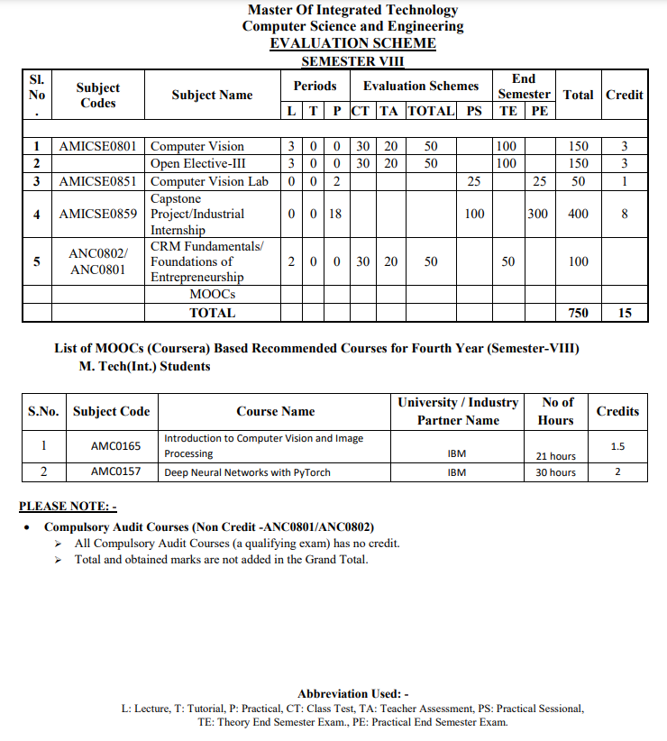
Evaluation Scheme

Slide 6
Evaluation Scheme

Slide 7
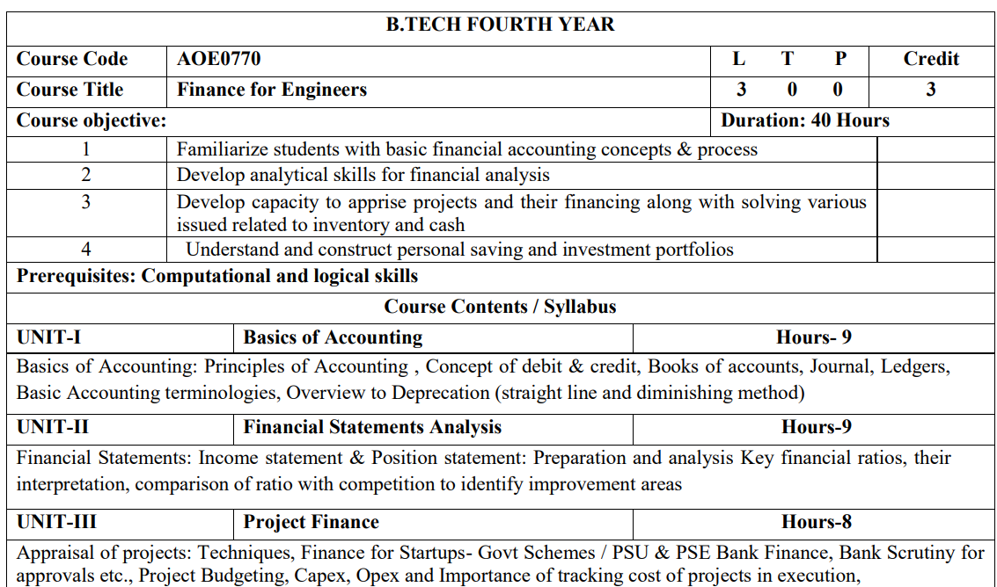
Syllabus

Slide 8

Syllabus

Slide 9
Branch Wise Application
Financial accounting can be used in short-term and long-term decisions involving the financial health of a company.
Financial accounting helps managers make operational decisions–intended to help increase the company's operational efficiency–which also helps in making long-term investment decisions.
Forecasting, monitoring, and tracking performance is a critical aspect of managerial accounting to ensure actual results meet the budgets and forecasts outlined at the onset.
Financial accounting is the type of accounting that provides financial information to top and middle level management in a company.
Financial accounting often involves various financial metrics, including revenue, sales, operating expenses, and cost controls.
Financial accounting helps companies plan, forecast, and budget at an enterprise-wide level to ensure the company's long-term success.

Slide 10
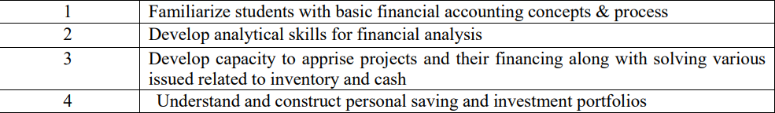
Course Objective(s)

Slide 11
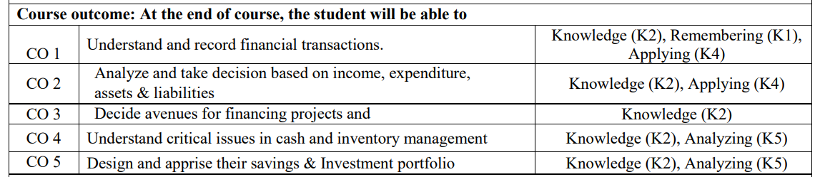
Course Outcome(s)

Slide 12
Program Educational Objective(s)
PEO 1: Plan and develop students to seek after a lifelong in Innovative work, Scholastics, and as software engineering proficient at public and worldwide level associations.
PEO 2: Empower students to seek after higher investigations, display research abilities and information to additional their profession desires
PEO 3: Use research-based data and gadgets for the examination and comprehension of data to consolidate information for getting significant finishes

Slide 13
Program Outcome(s)
S.NO. | Program Specific Outcomes | PSO Description
1 | PSO1 | Plan programming structures, parts, or cycles to resolve perceived issues inside monetary, regular and social necessities.
2 | PSO2 | Ability to apply numerical establishments and algorithmic standards for demonstrating and recreation of designing issues.
3 | PSO3 | Use research based information and devices for the investigation and understanding of information to combine data for getting substantial ends .

Slide 14
Co’s and Po’s Mapping
Sr. No | Course Outcome | PO1 | PO2 | PO3 | PO4 | PO5 | PO6 | PO7 | PO8 | PO9 | PO10 | PO11 | PO12
1 | AOE0770.1 | 3 | 3 | 2 | 2 | 2 | - | - | - | - | - | - | 1
2 | AOE0770.2 | 3 | 3 | 3 | 3 | 2 | - | - | 2 | 2 | 1 | - | 2
3 | AOE0770.3 | 3 | 3 | 3 | 3 | 2 | - | 1 | 2 | 2 | 1 | 2 | 2
4 | AOE0770.4 | 3 | 3 | 3 | 3 | 2 | 2 | 1 | 2 | 2 | 1 | 2 | 2
5 | AOE0770.5 | 3 | 3 | 3 | 3 | 2 | 3 | 2 | - | 3 | 3 | 2 | 3
6 | Average | 3.00 | 3.00 | 2.80 | 2.80 | 2.00 | 1.00 | 0.80 | 1.20 | 1.80 | 1.20 | 1.20 | 2.00

Slide 15
Result Analysis

Slide 16
End Semester Question Paper

Slide 17
Unit- 1 Accounting Fundamentals Recap
Accounting Basics: Accounting follows standard principles and the idea of debits and credits for tracking money flow. Ethical conduct is vital.
Books of Accounts:
Journal: Chronological record of all transactions.
Ledger: Tracks changes in individual accounts (assets, expenses, etc.)
Cash Book Specialized ledger specifically for cash.
Key Terminology: Assets, liabilities, equity, revenue, and expenses form the vocabulary of accounting.
Depreciation: Assets decrease in value over time. Straight line and diminishing balance methods are used to calculate this decrease in an asset's value.

Slide 18
Brief Introduction about the Subject
Accounting: The Foundation of Financial Decision-Making
Accounting is much more than just bookkeeping. It's a system designed to collect, organize, and communicate essential financial information about a business or organization. This information becomes the foundation for making sound economic choices.

Slide 19
What Accounting Tells Us
Performance: Accounting reveals whether a business is profitable or operating at a loss. It tracks income from sales alongside expenses like salaries, materials, and interest on loans. This tells owners, managers, and investors if the business is making money.
Financial Position: At any given moment, accounting shows the value of what a business owns (assets like cash, property, and inventory) versus what it owes (liabilities like loans and unpaid bills). This 'snapshot' of financial health is crucial for understanding a business's solvency.
Cash Flow: Accounting tracks the movement of cash into and out of the business. This is vital because even profitable businesses can fail if they run out of cash to pay immediate bills.

Slide 20
Why Does Accounting Matter?
Business Owners: Accounting helps owners track performance, identify areas for improvement, and make strategic decisions about pricing, expansion, and investments.
Investors: Investors rely on accurate accounting information to assess a company's financial health and potential for returns before investing their money.
Lenders: Banks and other lenders analyze a business's financial statements to determine its creditworthiness and decide whether to extend loans.
Government: Governments use accounting data to track economic activity, set tax policies, and ensure businesses comply with regulations.

Slide 21
Key Concepts in Accounting
Double-Entry Bookkeeping: Every transaction affects at least two accounts, creating a system of checks and balances.
Financial Statements: Accounting information is summarized in reports like the Income Statement (profit and loss), Balance Sheet (assets, liabilities, and equity), and Cash Flow Statement.
Accrual Accounting: This method records income when it's earned and expenses when they're incurred, not just when cash changes hands, giving a more accurate picture of performance.

Slide 22
ACOUNTANCY
It refers to a systematic knowledge of accounting. It explains the reasons and the processes of accounting.
It majorly, focuses on the explaining the method of preparing the books of accounts, and summarizing and communicating accounting information.
ACCOUNT
As bookkeeping, an account refers to assets, liabilities, income, expenses, and equity, as represented by individual ledger pages, to which changes in value are chronologically recorded with debit and credit entries. These entries, referred to as postings, become part of a book of final entry or ledger.

Slide 23
Accounting
Accounting refers to the actual process of preparing and presenting the accounts of an enterprise.
“Accounting is the art of recording, classifying and summarising in a significant manner and in terms of money”.
(AICPA-1961)

Slide 24
Functions of Accounting
1.Identifying economic information
Financing
Investing
operating
2.Measurement, 3.Recording, 4.Classifying
5.Summarising, 6.Analysing, 7.Intrepreting
8.Communicating

Slide 25
OBJECTIVES OF ACCOUNTING
1.Providing Information to the users for rational decision-making
2.Systematic Recording of Transactions
3.Ascertainment Results of Recorded Transaction
4.Ascertain the Financial Position of Business
5.To know the Solvency Position of Business

Slide 26
USERs OF ACCOUNTING
Accounting information is used for making better investment and credit decisions. The demand for accounting information of any entity comes both outside and inside the organization.
OUTSIDE USERS
Capital markets
Financial Institutions
Government Institutions
Social interest Group
INSIDE USERS
1.Management
2.Managers
3.Employees

Slide 27
LIMITATIONS OF ACCOUNTING
The limitations of accounting are as follows.
1.Financial nature
2.Historical costs
3.Measurement unit
4.Personal judgement
5.Estimates
6.Inexact information

Slide 28
FORMS OF ACCOUNTING
1.Financial Accounting:- It deals with the recording and summarising economical events and preparing financial statements in accordance with accepted accounting practices.
2.Cost accounting:- It deals with the computation of aggregate costs of products manufactured and/or services provided by using the same set of information used by the financial accounting. Or it estimates the total costs of produced/manufactured the goods or products during a specified period
3.Management Accounting- It relates to the use of financial and cost data for the purpose of evaluating the performance of the enterprise, reviewing the existing policies, and making decisions about new policies.
4.Taxation Accounting:- It involves preparing records and reports necessary for filling tax returns to local, state and central government authorities.

Slide 29
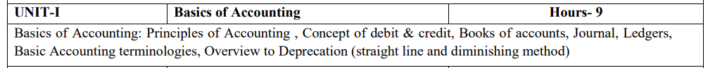
Unit Content
Notes:
UNIT-1: Basics of Accounting
1. Principles of Accounting
Generally Accepted Accounting Principles (GAAP): Introduce the standard rules and guidelines that ensure consistent and reliable financial reporting.
Accounting Concepts: Discuss foundational concepts like:
Business Entity: Separating business finances from personal finances.
Going Concern: The assumption that a business will operate indefinitely.
Accrual Basis: Matching revenue and expenses to the period they occur.
Conservatism: Anticipating losses, but not gains, to reflect a realistic financial picture.
2. Concept of Debit & Credit
Double-Entry Bookkeeping: Explain that for every transaction, there's always an equal debit and credit.
Rules of Debit/Credit: Teach how to increase/decrease different account types:
Assets: Debit increases, Credit decreases
Liabilities: Debit decreases, Credit increases
Equity: Debit decreases, Credit increases
Revenue: Debit decreases, Credit increases
Expenses: Debit increases, Credit decreases
3. Books of Accounts
Journal:
A chronological record of all business transactions.
Format: date, accounts affected, debit/credit amounts, brief description.
Ledger:
T-accounts summarizing changes to individual accounts.
Process of posting from the journal to the ledger.
Cash Book:
Specialized ledger focusing solely on cash transactions.
4. Basic Accounting Terminology
Assets: Resources owned by the business (cash, equipment, buildings).
Liabilities: Debts and obligations (loans, accounts payable).
Equity: Owner's investment in the business + profits – losses.
Revenue: Income from sales of goods or services.
Expenses: Costs incurred in running the business (salaries, rent).
5. Overview of Depreciation (Straight Line & Diminishing Method)
Concept of Depreciation: Spreading the cost of an asset over its useful life.
Straight-Line Method:
Calculation: (Asset Cost - Salvage Value) / Useful Life
Example: A machine costing $10,000 with a $1,000 salvage value and a 5-year life would depreciate $1,800 per year.
Diminishing Balance Method:
Calculation: Net Book Value * Depreciation Rate
Explain that it results in higher depreciation expense in early years.

Slide 30
Unit Objective
Specific Objectives:
Understanding Accounting Principles: Students should be able to:
Explain Generally Accepted Accounting Principles (GAAP) and their importance for accurate financial reporting.
Describe key accounting concepts like the business entity concept, going concern, accrual basis, and conservatism.
Debits and Credits Mastery: Students should be able to:
Define debits and credits and explain their meaning within accounting terminology.
Apply the rules of debit and credit to different types of accounts (assets, liabilities, equity, revenue, expenses).
Analyze transactions and correctly determine the corresponding debit and credit entries.

Slide 31
Unit Objective
Books of Original Entry: Students should be able to:
Explain the purpose and function of the journal, ledger, and cash book.
Demonstrate how to record transactions in the journal in chronological order.
Understand the process of posting transactions from the journal to the appropriate ledger accounts.
Accounting Terminology: Students should be able to:
Define essential accounting terms like assets, liabilities, equity, revenue, and expenses.
Use these terms correctly to describe a business's financial transactions and position.
Depreciation Fundamentals

Slide 32
Topic Objective and Topic Outcome
Students will learn about the accounting principles, concepts and conventions for their routine monetary transactions.
Students will understand the concepts of accounting equation and depreciation.

Slide 33
Topic- 1 Accounting Principles
Accounting principles may be defined as those rules of action or conduct which are opted by the accountants universally while recording accounting transactions.
Accounting principles can be subdivided into two categories
Accounting Concepts
Accounting Conventions

Slide 34
Accounting Concepts
GAAP or Generally Accepted Accounting Principles are the rules and procedures defined and developed by the Financial Accounting Standards Board (FASB) that an organization has to follow for the proper creation of financial statements consistent with the industry standards. The General Accepted Accounting Principles are also known as Accounting Concepts.
The primary objective of GAAP is to ensure a basic level of consistency in the accounting statements of an organization. Financial statements prepared with the help of GAAP can be easily used by the external users of the accounts of a company.
These are the basic ideas or assumptions under the theory base of accounting that provide certain working rules for the accounting activities of an organization. There are 11 important Accounting Concepts that are to be followed by companies to prepare true and fair financial statements.

Slide 35
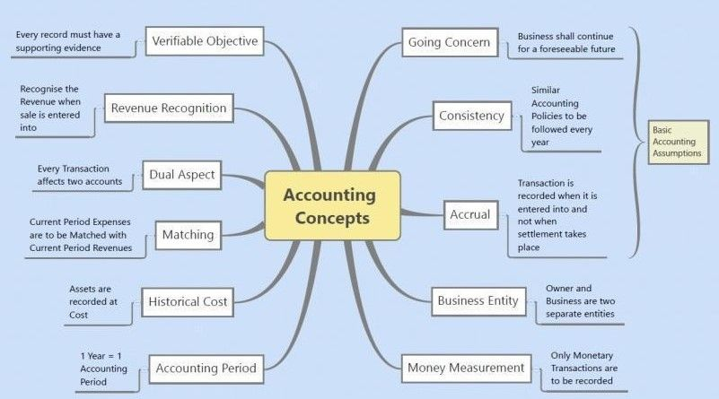
Accounting Concepts

Slide 36
Business Entity Concept
Under Business Entity Concept, a business is treated as separate from its owners. Business and owners are two independent entities because business too is considered as an artificial person. If an owner invests money in the business, it will be treated as a liability for the business. However, if the owner takes out some money from the business for personal use, it will be considered drawings. Therefore, the assets and liabilities of a business are the business’s assets and liabilities, not the owner’s. A business’s financial obligations are different from that of the owner.
Takeaways:
Businesses and owners are treated as separate entities while recording transactions.
Assets, liabilities, incomes, expenses, etc. belong to the business and not the owner.
Books of accounts are prepared from the viewpoint of the business and not the owner.
The business entity concept applies to partnerships, companies, sole proprietorships, small enterprises, and large enterprises.

Slide 37
Example of Business Entity Concept
Assume the owner needs to withdraw ₹50,000 for the construction of his/her own house. Such withdrawal acts will be known as Drawings, and it is not the expense of the business but the owner’s. The transaction must be written as Drawings to show the personal use of fund by the owner.
If the owner invests money in the business, the amount is considered a loan to the business and is the liability of the firm towards the owner. The business must repay the loan to its owner.

Slide 38
Money Measurement Concept
Money measurement concept can be defined as the concept under which the business needs to record only those transactions that can be expressed in terms of money. Money measurement concept undertakes only quantitative transactions and not qualitative ones. Qualitative transactions never get recorded in the books of accounts and thus never get reflected in financial statements. Quantitative transactions can be said to have a direct effect on the business whereas qualitative transactions have an indirect effect on the business.
Notes:
Takeaways:
Money measurement concept creates a single dominator for the purpose of measurement of performance, namely money.
This concept records only monetary transactions i.e. transactions that can be expressed in terms of money like, cash sales, cash purchases, assets sold for cash or on credit, salaries, rent, shares, etc.
This concept does not record those transactions that can not be expressed in terms of money like employee skill level, product durability, the efficiency of administrative processes, etc.

Slide 39
Example of Money Measurement Concept
As money measurement concept records only quantitative transactions that affect business directly and ignores transactions that affect business indirectly. Laboratories, in 2014, proved the high lead content in Maggi which turned out to be harmful for human consumption.
The downfall of Maggi caused goodwill and financial loss for the brand, but only financial loss was recorded in the books due to the money measurement concept. The controversy left a black dot on the goodwill of Nestle India, but this whole thing did not get recorded in the books of accounts because it can not be expressed in terms of money due to the money measurement concept.
The comeback of Maggi included strengthened customer service helplines, more engaging social media handles, and other PR activities, resulting in increased expenses from Maggi’s end. The increased expenses get a place in the books of accounts, but the efforts made to increase the sales get left out.
Notes:
Takeaways:
Money measurement concept creates a single dominator for the purpose of measurement of performance, namely money.
This concept records only monetary transactions i.e. transactions that can be expressed in terms of money like, cash sales, cash purchases, assets sold for cash or on credit, salaries, rent, shares, etc.
This concept does not record those transactions that can not be expressed in terms of money like employee skill level, product durability, the efficiency of administrative processes, etc.

Slide 40
Going Concern Concept
Going Concern Concept means an organization would continue its business operations indefinitely till the concept of bankruptcy and/or liquidation invades. This concept assumes that a business will continue to do its operations for the foreseeable future or at least for the next 12 months. The going concern concept has the following assumptions:
Acceptability of the core product: The company must have reasonably priced goods with innovation to beat its rival firms. The company must provide the customers with good quality products at reasonable prices to retain the customers and to acquire new customers.
Margin, Growth, and Volumes: An ideal going concern concept firm must have higher sales figures than the previous year. A higher operating and net profit margin is expected from the firm under going concern concept.

Slide 41
Features of Going Concern Concept
1. Continuity Assumption: The concept assumes that a business will continue its operations for the foreseeable future, typically at least 12 months from the reporting date.
2. Basis for Accounting: Financial Statements are prepared under the presumption that the company will continue its normal business activities without any intention of liquidation.
3. Assets Valuation: Assets are recorded at their historical value, depending on the accounting standards, with the expectation that they will continue to be used in the business.

Slide 42
Accounting Period Concept?
Accounting period concept tells the business to record all the transactions for a given accounting period for recording and analysis. Accounting period concept states that all the transactions that occur in a business should be divided into periods. This concept helps in the determination of profit and loss of a particular period and its comparison with the previous year and forecasting the figures for next years. An accounting period can be weeks, months, quarters, or even years.
Notes:
Takeaways:
The purpose of stating an accounting period is to report financial statements to the stakeholders for an informed decision-making process.
The comparison between the current year and previous years can be made, and the figures for the next accounting years can be forecasted.
Accounting period concept helps in determining the financial position of the company during a specific period.

Slide 43
Types of Accounting Period Concept?
1. Calendar year consists of a year starting from the first day of January and ending on the last day of December.
2. Fiscal year consists of a year starting from the first day of April and ending on the last day of March of the next year.

Slide 44
Requirements of Accounting Period Concept?
1. Accrual Method of Accounting: This method of accounting is a must in the accounting period concept. Accrual method of accounting tells the business to record the expenses and revenues as and when they occur and not necessarily when the monetary transactions happen concerning them. The focus of this method of accounting is to record the transactions irrespective of the time of monetary exchange.
2. Matching Principle: The matching concept states that an organisation should recognise its expenses in the same financial year if the expense is related to the revenue of that year. In simple words, if a firm is earning revenue in an accounting period, even though it incurs the expenses related to that revenue in the next accounting year, the expense will be realised in the same accounting year when the revenue has been realised by the firm.

Slide 45
Advantages of Accounting Period Concept?
1. Financial Statements: Accounting Period Concept helps in the preparation of financial statements like Trading A/c, Profit and Loss A/c, Balance Sheet, Income Statements, etc.
2. Reporting & Decision-Making: Accounting Period Concept helps in reporting the financial statements to all the stakeholders for a specified period and/or in chronological order so that investors and the board of directors can make informed decisions.
3. Comparison: The comparison between the current year and previous years can be made and the figures for the next accounting years can be forecasted.
4. Financial Health: Accounting period concept helps in determining the financial position of the company during a specific period. Potential investors can analyse the health of the company before investing.

Slide 46
Cost Concept
Cost concept in accounting states that the assets should be recorded at the cost at which they are acquired by the business, i.e. historical cost. Assets in the balance sheet should show the acquiring cost unless otherwise stated. Under the cost concept of accounting, all the assets are recorded at the original cost irrespective of market value. This concept is also known as the Cost Principle or Historical Cost Concept. This concept focuses on objectivity and reliability in financial reporting, as the historical cost is verifiable and less subjection to estimation.
If a company purchases a piece of machinery for $50,000, it will be recorded in the balance sheet at $50,000, the same as its historical cost.
A building bought for $1 million will be recorded at $1 million, even if its market value increases or decreases.
Notes:
Features of Cost Concept
1. Historical cost: Under this concept, assets are initially recorded at the actual cost incurred to acquire them. This cost includes the purchase price, taxes, transportation costs, and any other expenses directly attributable to bringing the asset to its present location and condition.
2. Objective: Historical cost is based on actual transactions and is not influenced by market fluctuations or subjective judgments. This makes financial statements more reliable and comparable.

Slide 47
Dual Concept
The Dual Concept of Accounting, also known as the Double-Entry Accounting System, can be defined as a principle in accounting that serves as the foundation for recording financial transactions accurately and consistently. The dual concept states that every financial transaction impacts at least two accounts in opposite ways, one account is debited and another account is credited by the same amount. This concept is based on the accounting equation:
Assets = Liabilities + Equity
Here, Assets represent what a company owns, and Liabilities represent what a company owes to other parties. Equity represents the amount that the owner has invested in the business. The dual concept ensures that this equation always remains in balance after each transaction.
Notes:
The dual concept states that every financial transaction has two equal and opposite effects on the company’s accounting records.
This concept ensures that the total assets are always equal to the total liabilities plus equity.

Slide 48
Features of Dual Concept
These features are explained as:
1. Double Entry System: Each transaction involves two entries, a debit entry and a credit entry. The dual concept states that every financial transaction impacts at least two accounts in opposite ways, one account is debited and another account is credited by the same amount.
2. Equality: The total debits must always be equal to the total liabilities, ensuring that the accounting equation is balanced.
3. Permanent Record: Every transaction is recorded in the books of accounts, creating a permanent and verifiable record of financial reporting.
4. Accuracy: The dual concept of accounting helps in detecting errors and ensures accuracy in financial statements.
5. Consistency: It provides a standardised and consistent method for recording transactions, facilitating easy comparison.

Slide 49
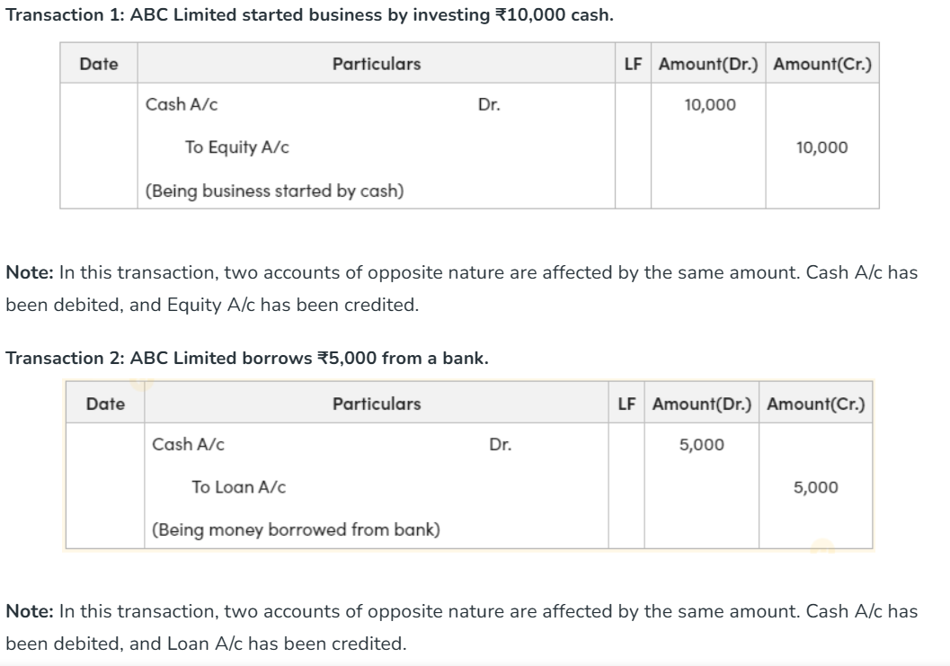
Example of Dual Concept
Notes:
Rohan started a business by investing a sum of ₹1 crore. This amount will increase the cash (asset side) of the business, and will also increase its capital by the same amount, i.e., ₹1 crore. Therefore, the effect of the transaction will be shown in two accounts, i.e., cash and capital account. The dual concept forms the base of the Double Entry System of Accounting.

Slide 50
Revenue Recognition Concept
The Revenue Recognition Concept is defined as a fundamental principle in accounting that dictates when and how a business should recognize revenue in its financial statements. Essentially, it outlines the conditions under which revenue is considered earned and should be recorded. According to this concept, revenue is generally recognized when it is earned and realizable, meaning that the goods or services have been delivered or rendered, and the company can reasonably expect to receive payment. This principle is crucial for providing an accurate representation of a company’s financial performance, as it ensures that revenue is recognized in the appropriate accounting period, reflecting the economic substance of transactions.
Notes:
Takeaways:
Revenue Recognition Concept guides businesses to recognize revenue when the earnings process is complete, regardless of when the actual cash payment occurs.
This departure from a purely cash-based approach aligns with the accrual basis of accounting, allowing for a more accurate portrayal of a company’s financial position by matching revenues with the costs incurred to generate them.
Adherence to the Revenue Recognition Concept is essential for financial reporting accuracy maintaining transparency and providing stakeholders with a reliable basis for decision-making and performance evaluation.

Slide 51
Example of Revenue Recognition Concept
Let’s consider a software company that sells annual subscriptions to its cloud-based project management software. When a customer purchases a one-year subscription, the Revenue Recognition Concept dictates that the company should not recognize the entire subscription revenue upfront but rather spread it over the subscription period. So, if the customer pays $1,200 for the one-year subscription, the company would recognize $100 of revenue each month for 12 months. This aligns with the concept’s emphasis on recognizing revenue when it is earned over time, reflecting the ongoing delivery of the software service to the customer.
Another example involves a construction company working on a long-term infrastructure project. Instead of recognizing the entire contract value as revenue at the project’s initiation, the Revenue Recognition Concept requires the company to recognize revenue as it reaches specific milestones or as costs are incurred. For instance, if a project is expected to take two years to complete with agreed-upon milestones, revenue is recognized gradually as those milestones are achieved, providing a more accurate reflection of the company’s progress and performance.
Notes:
Significance of Revenue Recognition Concept
The significance of the Revenue Recognition Concept lies in its crucial role in financial reporting, decision-making, and overall business transparency. Here are key points highlighting its significance,
1. Investor Confidence: Revenue Recognition Concept builds investor confidence by providing a transparent and accurate representation of a company’s revenue, fostering trust and positive perception among investors.
2. Strategic Planning: Revenue Recognition Concept provides a foundation for strategic planning by offering a clear understanding of a company’s revenue streams, enabling management to make informed decisions about resource allocation and future business strategies.
3. Credibility and Trustworthiness: Revenue Recognition Concept enhances the credibility of financial statements, promoting trust with stakeholders, including investors, creditors, and regulatory bodies.
4. Avoidance of Misrepresentation: Revenue Recognition Concept prevents misrepresentation of a company’s financial position by discouraging the manipulation of revenue recognition timing for short-term gains.
5. Standardized Reporting: Revenue Recognition Concept contributes to standardized reporting practices across industries, allowing for consistent evaluation and benchmarking of financial performance.
6. Improved Stakeholder Relations: Revenue Recognition Concept strengthens relationships with stakeholders by providing clear, consistent, and reliable information about a company’s revenue, fostering transparency and openness.

Slide 52
Revenue Recognition Principles
1. Realization Principle: This principle dictates that revenue should be recognized when it is realized, realizable, and earned. Realization refers to the point at which goods or services are exchanged for cash or claims to cash.
2. Matching Principle: The Matching Principle states that expenses should be recognized in the same period as the revenue they help generate. It ensures that the costs associated with earning revenue are appropriately matched with that revenue.
3. Conservatism Principle: The Conservatism Principle suggests that when there is uncertainty about the amount or collectability of revenue, it is prudent to recognize less rather than more. This principle helps in avoiding the overstatement of assets and profits.

Slide 53
Revenue Recognition Principles
4. Full Disclosure Principle: The Full Disclosure Principle requires a company to disclose all material information relevant to its financial statements. This includes information about the methods used for revenue recognition and any potential uncertainties or risks associated with revenue transactions.
5. Consistency Principle: The Consistency Principle emphasizes the importance of applying consistent accounting methods within a company over time. This ensures that financial statements are comparable across different periods.

Slide 54
Matching Concept
The matching concept states that an organization should recognize its expenses in the same financial year if the expense is related to the revenue of that year. In simple words, if a firm is earning revenue in an accounting period, even though it incurs the expenses related to that revenue in the next accounting year, the expense will be realized in the same accounting year when the revenue has been realized by the firm.
For example, if a salesman sells goods worth ₹10,00,000 in February 2022 on a 6% commission made in May 2022, the commission expense of 6% will be charged in the accounting year in which the sales have been made, i.e., 2021-2022. A company should keep in mind that the matching concept should be followed only after the realisation concept has been fulfilled.
Notes:
Imagine "Creative Web Solutions," a web design company, completes a project for a client in December 2023 and invoices the client $10,000, which it receives in January 2024. In completing this project, the company incurred costs such as designer salaries of $6,000 and software subscriptions of $1,000 in December 2023.
Revenue Recognition: According to the matching concept, the revenue from the project ($10,000) is recognized in December 2023, when the service was completed and delivered to the client, not in January 2024, when the payment was received.
Expense Recognition: Similarly, the expenses related to the project (designer salaries of $6,000 and software subscriptions of $1,000) are also recognized in December 2023, matching the period in which the revenue was earned.
Profit Calculation: The profit for December 2023 is calculated by subtracting the total expenses ($7,000) from the revenue earned ($10,000), resulting in a profit of $3,000 for that period.
By applying the matching concept, Creative Web Solutions accurately reflects its financial performance for December 2023, showing how efficiently it utilized its resources to generate profit. This approach provides stakeholders with a clearer picture of the company's operational effectiveness and profitability during a specific accounting period.

Slide 55
Accounting Conventions
Accounting conventions are certain guidelines for complicated and unclear business transactions. While standardizing the financial reporting process, these conventions consider comparison, relevance, full disclosure of transactions, and application in financial statements.
Types of Accounting Conventions:-
Consistency
Full Disclosure
Materiality
Conservatism

Slide 56
Consistency Concept
The consistency concept is a key idea in accounting, which highlights how crucial it is for an organization to employ the same accounting procedures, practices, and policies over time. It guarantees that financial statements are similar among intervals, making it possible for stakeholders to assess the performance and role of an entity’s price range with accuracy.
Companies must maintain consistency by applying constant accounting methods for similar transactions and occurrences for the duration of reporting intervals and refrain from making frequent adjustments to accounting guidelines unless needed.
Organizations can gain trust among traders, creditors, regulators, and other customers of economic factors using upholding regular accounting techniques, which improve the dependability, credibility, and transparency of their economic reporting.
Notes:
Takeaways:
Consistency in accounting methods is crucial for ensuring comparability in financial reporting.
Consistency helps mitigate bias and distortion in financial reporting.
If accounting methods are changed frequently, it can lead to fluctuations in reported financial results that may not necessarily reflect the underlying performance of the business.

Slide 57
Convention of Consistency
The convention of consistency means that same accounting principles should be used for preparing financial statements year after year. A meaningful conclusion can be drawn from financial statements of the same enterprise when there is comparison between them over a period of time.
Notes:
The Convention of Consistency is an accounting principle that emphasizes the need for uniformity in accounting methods and practices over time within a business. This convention ensures that financial statements of different periods are comparable, allowing stakeholders to accurately assess the financial performance and condition of the business across those periods. By maintaining consistent accounting policies and procedures (such as depreciation methods, inventory valuation methods, and accounting for revenues and expenses), businesses provide a reliable basis for comparison and decision-making.
Examples:-
Global Tech Solutions," a company specializing in software development, uses the straight-line method for depreciating its fixed assets. According to the convention of consistency, Global Tech Solutions should continue using the straight-line depreciation method for all its fixed assets in subsequent accounting periods, unless there is a valid reason to change methods.
Application: In 2023, Global Tech Solutions acquires new office equipment for $100,000 with an expected useful life of 10 years and no salvage value. Using the straight-line method, the annual depreciation expense is $10,000. For consistency, the company will continue to use this method for calculating depreciation on all its fixed assets in the future.
Impact on Financial Statements: By consistently applying the straight-line depreciation method, the financial statements of Global Tech Solutions from year to year will reflect a uniform charge for depreciation. This allows stakeholders, such as investors, creditors, and analysts, to make meaningful comparisons of the company's operating performance and financial position over time.
If a Change is Necessary: Should Global Tech Solutions decide to change its depreciation method to better reflect the usage pattern of its assets (e.g., switching to the declining balance method), it must fully disclose the nature of the change, the reasons for the change, and the impact on its financial statements. This transparency ensures that users of the financial statements are aware of the change and can adjust their comparisons accordingly.
The convention of consistency is crucial for ensuring reliability and comparability in financial reporting, which in turn aids in the accurate assessment of a business's financial health and trends over time.

Slide 58
Convention of Conservatism
The Convention of Conservatism, also known as the principle of prudence, is an accounting guideline that advises erring on the side of caution when faced with uncertainty in financial reporting. This principle dictates that potential expenses and liabilities should be recognized promptly, but revenue should only be recognized when it is assured. Essentially, it means that accountants should not overestimate the value of revenues or assets, nor underestimate the value of expenses or liabilities. The goal is to avoid overstating the financial position or profitability of a business, thus providing a more realistic view of its financial health.
Notes:
Convention of conservatism Example:----
"Oceanic Ventures," a company engaged in marine exploration, faces a potential lawsuit related to environmental damage. The outcome of the lawsuit is uncertain, but there's a possibility it could result in significant financial penalties for the company.
Application of the Convention of Conservatism: Given the uncertainty and potential for a financial loss, Oceanic Ventures decides to record a provision (an estimated expense) for the lawsuit in its financial statements, reflecting the expected financial impact based on legal advice and previous similar cases. This action acknowledges the potential liability, even though the lawsuit's outcome is not finalized.
Impact on Financial Reporting: By recording a provision for the lawsuit, Oceanic Ventures' financial statements more accurately reflect the company's financial position, taking into account the possible future outflow of resources. This conservative approach ensures that the financial statements do not overstate the company's net assets or profitability.
Revenue Recognition: Similarly, if Oceanic Ventures is negotiating a significant contract expected to generate substantial revenue, the convention of conservatism dictates that this revenue should not be recognized until the contract is finalized and the revenue is virtually certain. This avoids the premature recognition of income that may not materialize.
The Convention of Conservatism plays a critical role in financial reporting by providing a safeguard against the overoptimistic presentation of a company's financial condition. It ensures that financial statements are prepared with a degree of caution, helping protect stakeholders from being misled by overly positive financial results that may not reflect the company's actual financial risks or uncertainties.

Slide 59
Convention of Full Disclosure
Relevant and important information regarding the company’s financial status must be revealed in financial statements even after applying the accounting convention. E.g. Contingent Liabilities, and Law Suits against a business should be reported in adjoined notes in the company’s financial statements.

Slide 60
Convention of Materiality
The materiality concept accounting is subjective relative to size and importance. Financial information might be of material importance to one company but stand immaterial to another company. This aspect of the materiality concept is more noticeable when comparing companies that vary in size, i.e., a large company vis-à-vis a small company. A similar cost may be considered a large and material expense for a small company, but the same may be small and immaterial for a large company because of its large size and revenue.
Notes:
The materiality concept refers to a situation where the financial information of a company is considered material from the point of view of the preparation of the financial statements if it has the potential to alter the view or opinion of a reasonable person. In short, all that financial information that is likely to influence a knowledgeable person’s judgment should be captured in the preparation of the company’s financial statements. The materiality concept in accounting is also known as materiality constraint.
The materiality concept accounting is subjective relative to size and importance. Financial information might be of material importance to one company but stand immaterial to another company. This aspect of the materiality concept is more noticeable when comparing companies that vary in size, i.e., a large company vis-à-vis a small company. A similar cost may be considered a large and material expense for a small company, but the same may be small and immaterial for a large company because of its large size and revenue.
The financial statement users mentioned here can be auditors, shareholders, investors, etc. As such, it can be said that the main objective of the materiality concept in accounting is to assess whether the financial information under consideration makes any significant impact on the opinion of the financial statement users. If the information is not material, the company does not need to worry about including it in financial statements.
In general, the thumb rule for the materiality of financial information is stated as,
On the Income statement,, a variation of more than 5% of before-tax Profit or more than 0.5% of sales revenue may be seen as “large enough to matter.”
On the Balance sheet, a variation in the entry of more than 0.5% of total assets or more than 1% of total equity may be viewed as “large enough to matter.”

Slide 61
Examples of Convention of Materiality
Let us take the example of a large company with a building located in the hurricane zone during the recent natural calamity. The hurricane has destroyed the company building, and after a gruesome legal battle with the insurance provider, the company has reported an extraordinary loss of $30,000. Determine the materiality of the event based on the below-given conditions:
Company A which is large and generates a net income of $40,000,000
Company B which is very small and generates a net income of $90,000

Slide 62
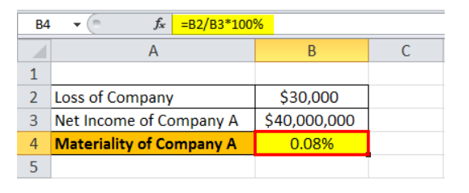
Examples of Convention of Materiality
A) Now, let us calculate the materiality for company A by dividing the loss of $30,000 by the net income of the company i.e. $30,000 / $4,000,000 * 100% = 0.08%
By using the above-given data, we will calculate the Materiality of Company A
The materiality of Company A =0.08%
According to the materiality concept, this loss of $30,000 is immaterial for company A because the average financial statement user would not be concerned with something that is only 0.08% of the total net income.

Slide 63
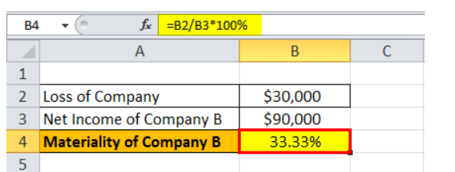
Examples of Convention of Materiality
b) Again, let us calculate the materiality for company B by dividing the loss by the net income of the company, i.e., $30,000 / $90,000 * 100% = 33.34%
Now, we will calculate the Materiality of Company B.
The materiality of Company B = 33.33%
According to the materiality concept, this loss of $30,000 is material for company B because the average financial statement user would be concerned and might opt out of the business. The loss constitutes around 33.33% of the total net income.
The above example emphasizes the difference in the size of the two companies and the variation in the behavior of their financial statement users.

Slide 64
Book Keeping and Accounting
Bookkeeping and Accounting are essential components of a business's financial management system, but they serve different functions and involve distinct processes:
Bookkeeping:
Bookkeeping is the process of recording daily financial transactions in a systematic and chronological order. It involves the documentation of financial transactions, including purchases, sales, receipts, and payments, ensuring that all financial transactions are accurately captured in the company's books. transactional data to support financial analysis and reporting.
Notes:
Key Responsibilities:
Recording financial transactions in the journal and ledger.
Managing invoices and tracking accounts receivable/payable.
Reconciling bank statements.
Maintaining and balancing ledgers, journals, and other records.
Bookkeeping is foundational for the accounting process, providing the necessary

Slide 65
BOOK-KEEPING
It is a science and art of correctly recording in books of accounts all those business transactions that result in transfer of money or moneys worth. It also focuses on classifying financial data related to business operation in order of its occurrence.
Book-keeping is a mechanical task which involves:
Collection of basic financial information.
Identification of events and transaction with financial character
Measurement of economic transactions in terms of money.
4. Recording financial effects of economic transactions in order of its occurrence.
5. Classifying effects of economic transactions.
6. Preparing organised statement known as trial balance.

Slide 66
Accounting
Accounting:
Accounting is a broader and more complex process that involves interpreting, classifying, analyzing, summarizing, and reporting financial data. Accounting takes the information recorded by bookkeeping and uses it to produce financial statements. It also involves assessing the financial health of the business and making future financial predictions.
Double Entry System :
This system takes into account every business transaction in its double aspect.
Notes:
Key Responsibilities:
Preparing adjusting entries (recording expenses that have occurred but aren't yet recorded in the bookkeeping process).
Preparing financial statements (income statement, balance sheet, cash flow statement).
Analyzing financial statements to help inform business decisions.
Assisting with budgeting and financial planning.
Ensuring compliance with tax laws and preparing tax returns.

Slide 67
Nature of Accounts
Nature of Accounts
1.Personal account:- It is concerned with the name of account of an artificial person or a natural person. Example:-- A/c of Rakesh, A/c of ABC Co. ltd. Etc.
2. Real account :- It is concerned with the accounts of assets which help the business to earn profits. Such as- Machinery A/c, Building A/c, Cash A/c etc.
3.Nominal account:- It is concerned with the accounts of incomes and expenses. Such as- Rent A/c, salary A/c etc.

Slide 68
Golden /Double Entry Rules of Accounting 1
RULES OF ACCOUNTING
1. In case of personal account
Personal accounts relate to individuals, firms, companies, and other entities. The rule for personal accounts is:
Debit the receiver: When a person or entity receives something, that person's or entity's account is debited.
Credit the giver: When a person or entity gives something, that person's or entity's account is credited.
Example: If the company pays John (a creditor) $500, John's account (Personal Account) will be credited because he is the giver. Conversely, the Cash account (an asset, thus treated here for illustrative purposes) will be debited because the company is spending cash.

Slide 69
Golden /Double Entry Rules of Accounting 2
2. In case of real account
Real accounts pertain to assets and properties of a business — both tangible and intangible. The rule for real accounts is:
Debit what comes in: When the business acquires or receives an asset, the asset account is debited.
Credit what goes out: When an asset is given away or sold, the asset account is credited.
Example: If the company purchases machinery for cash, the Machinery account is debited (because machinery comes into the business), and the Cash account is credited (because cash goes out of the business).

Slide 70
Golden /Double Entry Rules of Accounting 3
3. In case of nominal account
Nominal accounts are related to expenses, losses, incomes, and gains. The rule for nominal accounts is:
Debit all expenses and losses: When the business incurs an expense or suffers a loss, the respective expense or loss account is debited.
Credit all incomes and gains: When the business earns income or gains, the respective income or gain account is credited.
Notes:
Example: If the company earns service revenue, the Service Revenue account (Nominal Account) is credited because it represents an income. If the company pays rent, the Rent Expense account is debited, reflecting an expense.
These rules of accounting ensure that every transaction is accurately recorded in the company's books, maintaining the integrity of financial statements. By applying these rules consistently, businesses can ensure that their financial reporting is in line with accounting standards, providing clear and reliable information for stakeholders.

Slide 71
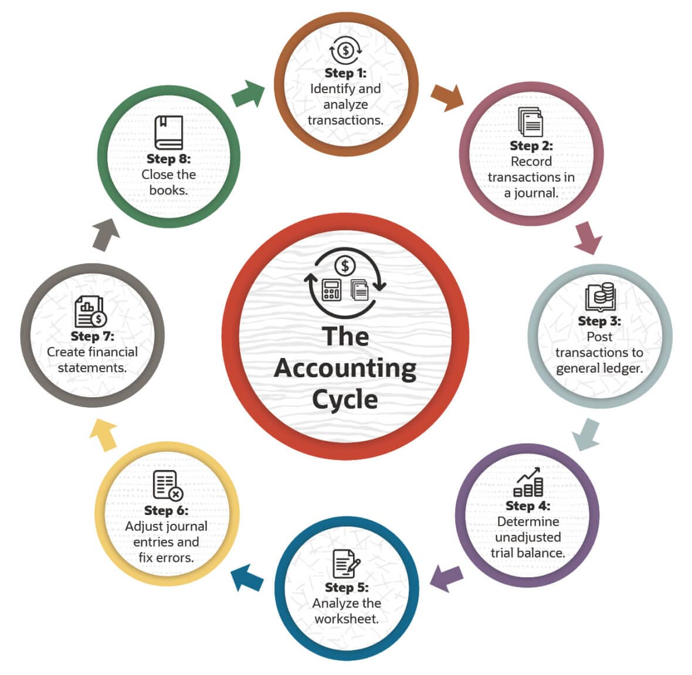
Accounting cycle

Slide 72
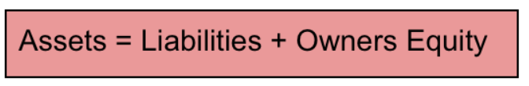
Accounting Equation
The financial position of any business, large or small, is based on two key components of the balance sheet: assets and liabilities. Owners’ equity, or shareholders’ equity, is the third section of the balance sheet.
The accounting equation is a representation of how these three essential components are associated with each other.
Assets represent the valuable resources controlled by a company, while liabilities represent its obligations. Both liabilities and shareholders’ equity represent how the assets of a company are financed. If it’s funded through debt, it’ll show as a liability, but if it’s financed through issuing equity shares to investors, it’ll show in shareholders’ equity.

Slide 73
What Are the Three Elements in the Accounting Equation Formula?
Assets
Assets represent the ability your business has to provide goods and services. In other words, it includes all things of value used to perform activities such as production and sales.
We divide assets into two main categories: short-term and long-term.
Short-term assets are expected to be consumed within a year. They include:
Cash and cash equivalents
Inventory
Accounts receivable
Prepaid expenses
Long-term assets extend their use over the one year. They can be either tangible (physical) or intangible.
Tangible assets are buildings, land, and equipment. Intangible ones consist of patents, trademarks, or copyrights.

Slide 74
What Are the Three Elements in the Accounting Equation Formula?
Liabilities
Liabilities (or obligations) are assets owed to creditors. Creditors include people or entities the business owes money to, such as employees, government agencies, banks, and more.
We classify liabilities the same way we do assets, based on current, or long-term periods of time.
Current or short-term liabilities are employee payroll, invoices, utility, and supply expenses. Long-term liabilities cover loans, mortgages, and deferred taxes.

Slide 75
What Are the Three Elements in the Accounting Equation Formula?
Owner’s Equity
The owner’s equity is the value of assets that belong to the owner(s). More specifically, it’s the amount left once assets are liquidated and liabilities get paid off.
Let’s check out what causes increases and decreases in the owner’s equity.
Increases in Owner’s Equity - Two primary sources cause an increase in owner’s equity: owner investments and revenue. Investments are the cash the owner personally puts into their business. These investments are recorded under a category called the owner’s capital. Conversely, revenues represent profit from business activities such as sales, fees, renting a property, lending cash, commissions, and more.
Decreases in Owner’s Equity—Decreases in equity happen from drawings and expenses. Drawings are the cash the owner withdraws from the business accounts, while expenses are the costs that come from consumed assets, such as the purchase of equipment, wages, utility expenses, taxes, and so on.

Slide 76
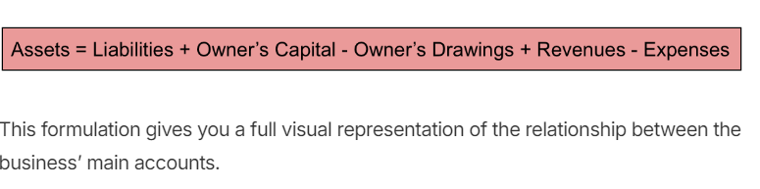
Extended Version of The Accounting Equation
Now, there’s an extended version of the accounting equation that includes all of the elements (described in the section above) that comprise the Owner’s Equity.

Slide 77
Accounting Equation Extended Version
This isn’t the only type of rearrangement you can make to the accounting equation, though. It can be transformed and interpreted into two other forms:
1. Owner’s equity = Assets - Liabilities
At first glance, you probably don’t see a big difference from the basic accounting equation. However, when the owner’s equity is shifted on the left side, the equation takes on a different meaning.
It’s telling us that creditors have priority over owners, in terms of satisfying their demands. While the basic accounting equation’s main goal is to show the financial position of the business.
2. Net Worth = Assets - Liabilities
This is another form of the equation you may come across. It’s essentially the same equation because net worth and owner’s equity are synonymous with each other. Other names for owner’s equity you may face are also net assets, or stockholder’s equity (for public corporations).

Slide 78
Double-Entry Bookkeeping Method
Every business transaction has a double effect on the accounting equation. For instance, if an asset increases, there is always one corresponding:
Decrease in another asset
Increase in liability or
Increase in owner’s equity.
Now, these changes in the accounting equation get recorded into the business’ financial books through double-entry bookkeeping.
Double-entry bookkeeping is a system that records transactions and their effects into journal entries by debiting one account and crediting another.
Debits are cash flowing into the business, while credits are cash flowing out.
For every debit entry, there has to be an equal credit entry. So debits and credits should always balance in the end.

Slide 79
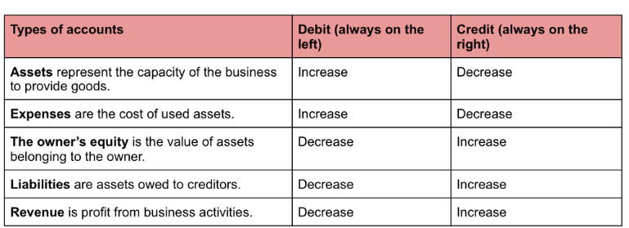
Double-Entry Bookkeeping Method
To understand which accounts get debited or credited when money changes, we’ve made a cheat sheet so you can easily understand.

Slide 80
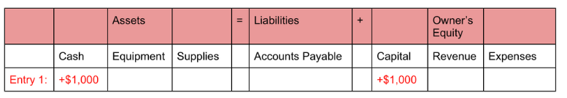
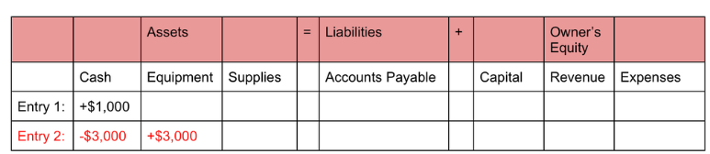
Accounting Equation Example
Assume the following examples are transactions for XYZ company during their first month of work:
1. The business owner invests $10,000 in Company XYZ. This transaction will increase $10,000 in both the cash asset and owner’s equity capital. The equation would look as shown below:
2. Company XYZ purchases $3,000 of equipment. In this case, $3,000 in assets are increased and decreased. The cash account will decrease while the equipment account increases. This is how the entry would look like in the equation:

Slide 81
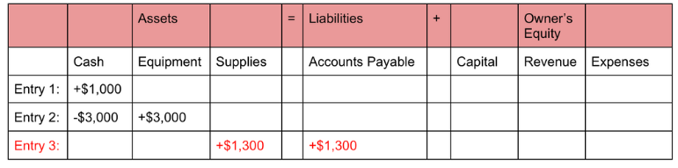
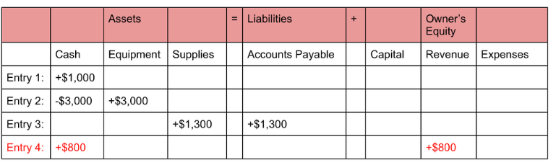
Accounting Equation Example
3. Company XYZ purchases $1,300 of supplies on credit. This transaction causes an increase of $1,300 in both assets and accounts payable liability. Concretely, the accounts affected are the supplies and accounts payable. This third transaction would appear like this in the equation:
4. XYZ receives $800 cash from customers for services provided. When obtaining cash from services the two accounts that increase by $800 are the cash and revenue ones. The accounting equation would look like this:

Slide 82
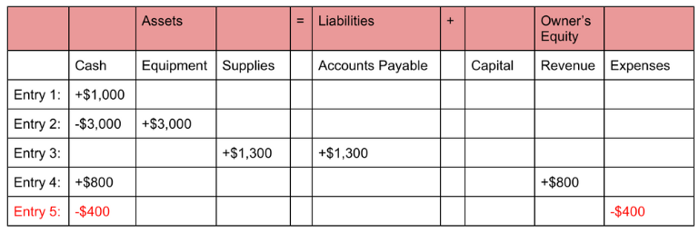
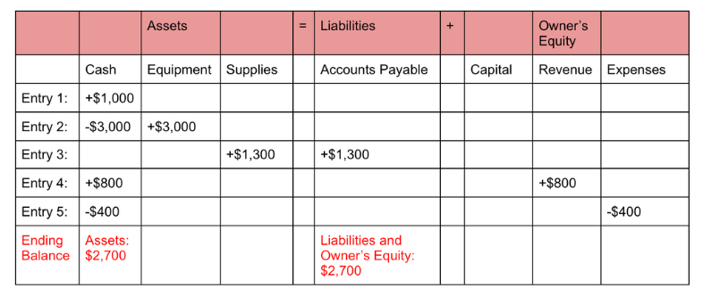
Accounting Equation Example
5. XYZ pays $400 expense for employee salaries. The effect of this payment is an equal decrease of $400 on the cash account, and expenses account. This transaction would look as follows:
If we add up both sides of the equation they will equal to $27,00 and balance, as shown below:

Slide 83
Accounting Equation Key Takeaways
The accounting equation, a straightforward and fundamental tool, facilitates double-entry bookkeeping for all businesses, regardless of size or purpose. It elegantly represents the relationship between three main entities: assets, liabilities, and owner’s equity.
Assets are the business resources, such as cash, inventory, and buildings. Liabilities are obligations to creditors, such as invoices, loans, and taxes. The owner’s equity represents assets belonging to the owner or shareholders.
The accounting equation can be rearranged into three different ways:
Assets = Liabilities + Owner’s Capital - Owner’s Drawings + Revenues - Expenses
Owner’s equity = Assets - Liabilities
Net Worth = Assets - Liabilities
Changes in the accounting equation get recorded through double-entry bookkeeping.
The balance sheet is a financial statement representing the accounting equation in a more detailed and expanded manner.
The main limitation of the accounting equation is that it doesn’t analyse how well the business is operating.

Slide 84
Accounting Equation Exercise For Students
Question 1: Prepare accounting equations for the following transactions:
1) Started business with cash 74,00,000 and machine 710,000.
2) Purchased goods for 1,00,000 immediately by paying 50% in cash.
3) Cash withdrawn from bank 770,000.
4) Salary payable 760,000, of which 60% is outstanding.
5) Sold goods costing? 70,000 for 780,000.

Slide 85
Accounting Equation Exercise for Students
Question 2: Prepare accounting equations for the following transactions:
Show the effect of the following business transactions on assets, liabilities and capital through an accounting equation:
1) Commenced business with cash * 20,000.
2) Goods purchased on credit 77,000.
3) Furniture purchased 73,000.
4) Paid to creditors 72,000.
5) Amount withdrawn by the proprietor 4,000.
6)Creditors accepted a bill for 81,500.
7)Interest on capital 71,000.
8)Transfer from capital to loan 85,000.
9)Allotted shares to creditors 71,000.

Slide 86
Accounting Function
These terms represent key components and stages in the accounting and bookkeeping process, each serving a specific function in the preparation of a business's financial statements. Here's a brief overview of each:
Waste Book
Journal
Ledger
Trial Balance
Final Accounts

Slide 87
Waste Book
The term "Waste Book" is historical and refers to the initial book or document where all transactions were recorded in chronological order as they occurred, without any categorization or organization. It was essentially a rough record of transactions, used as the primary data source for more systematic accounting records. In contemporary accounting, this concept closely aligns with the general journal, although the term "Waste Book" is rarely used today.

Slide 88
Journal
A journal is a detailed account that records all the financial transactions of a business, which can be used for future reconciling and transfer to other official accounting records, such as the general ledger.
A journal, in accounting, is known as the book of original entry or the first place where transactions are recorded according to the date of occurrence. The recording of transactions in a journal is based on the double-entry bookkeeping system, where each transaction affects at least two accounts, with at least one debit entry and one credit entry. The journal entry includes the date of the transaction, the accounts involved, the amounts to be debited and credited, and a brief description of the transaction.
The journal is the book of prime entry, also called the book of original entry. Transactions are first entered here, and it is the most important book of accounts. The transactions are recorded systemically and in chronological order.
They are entered to show which accounts should be debited or credited. Recording of transactions in a “Journal” is called “Journalising the entries.”
“Journal” is derived from the Latin word ‘Jour’, which means ‘a day’. The transactions are first entered here and then subsequently posted to another account book called “Ledger.”

Slide 89
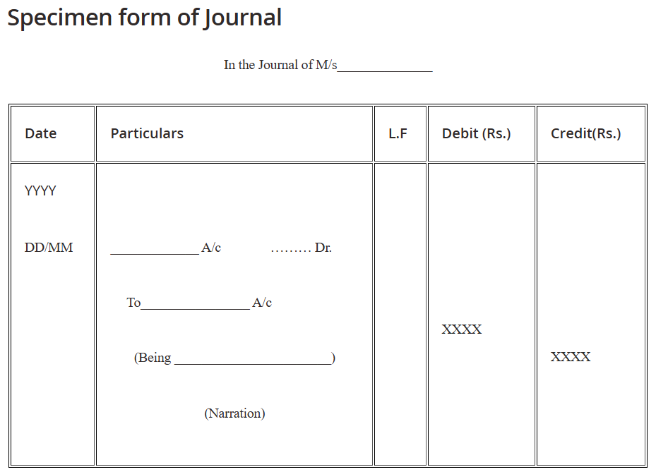
Journalizing Process

Slide 90
Journalizing Process
Date Column: In the first column the date of the transaction is entered, the year is most probably written on the top of the column than to repeat it every day.
Particulars Column: Here the accounting entry is written in a summarised form of debit and credit. The names of the accounts involved in the transaction are written in the journal entry.
On the first line, the account is debited, the word “Dr.” is written at the right end of the same line of account debited.
On the second line, the account credited is written with a prefix “To” after leaving a little space towards the start.
Immediately below the entry, a small explanation of the transaction called ‘narration’ is written. The narration begins with the word “Being”.
Ledger Folio No. Column (L.F.): In this column, the page number of the Ledger in which the journal entry is posted, is recorded. This also helps is easy cross verification and reference in the future.
Debit Amount Column: The amounts to be debited to the accounts concerned or involved are written.
Credit Amount Column: The amounts to be credited to the accounts concerned or involved are written.

Slide 91
Steps in Journalizing Transactions
First of all, read and understand the transaction because it may be either in a cash transaction or credit transaction.
Journal entries can be single entry i.e. one debit and one credit or can be a compound entry (one or more debits and one or more credits)
A transaction not including any person’s name is considered as a cash transaction. So, if a person’s name is given along with certain words like ‘Cash’, ‘Bank’, ‘Received’, ‘Earned’, ‘Paid’, ‘Spent’, ‘Deposited’, ‘Withdrawn’, ‘Borrowed’, etc. then the transaction is considered as “Cash Transaction”.
In a credit transaction, out of the two accounts in the transaction, certainly, one account is Personal Account and the second account is Real Account.
As per the nature and types of accounts, apply the rules of journalisation to give debit or credit effects.
Record the date of the transaction in the first column which is the date column.
In the particulars column, account to be debited on the first line with the abbreviation ‘Dr.’ on the right side of the same line.

Slide 92
Example
Question: Journalise the following transactions in the Journal of Mr. Kiran for the year 2018
January 1 – Paid rent Rs. 4000/-
January 2 – Sold goods to Harsh for Rs. 10,000/-

Slide 93
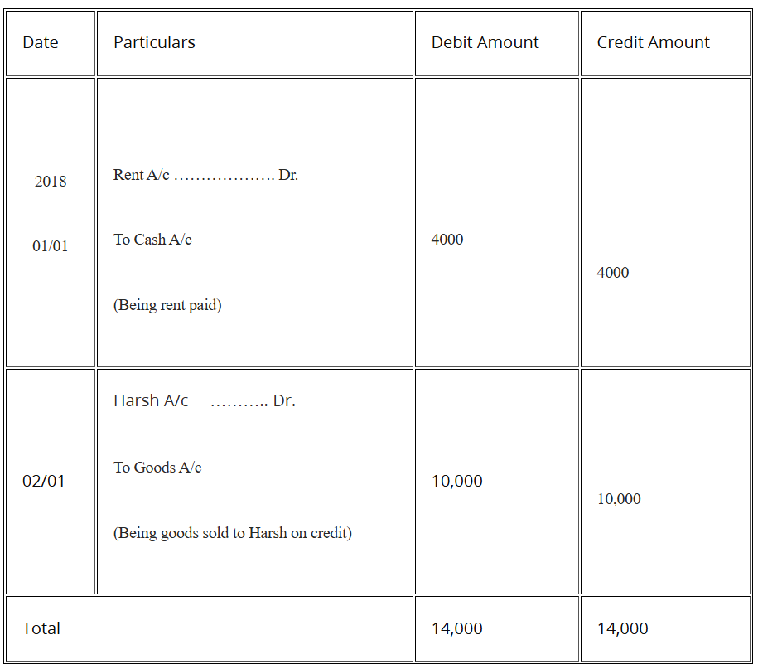
Example Answer :In the Journal of Mr. Kiran

Slide 94
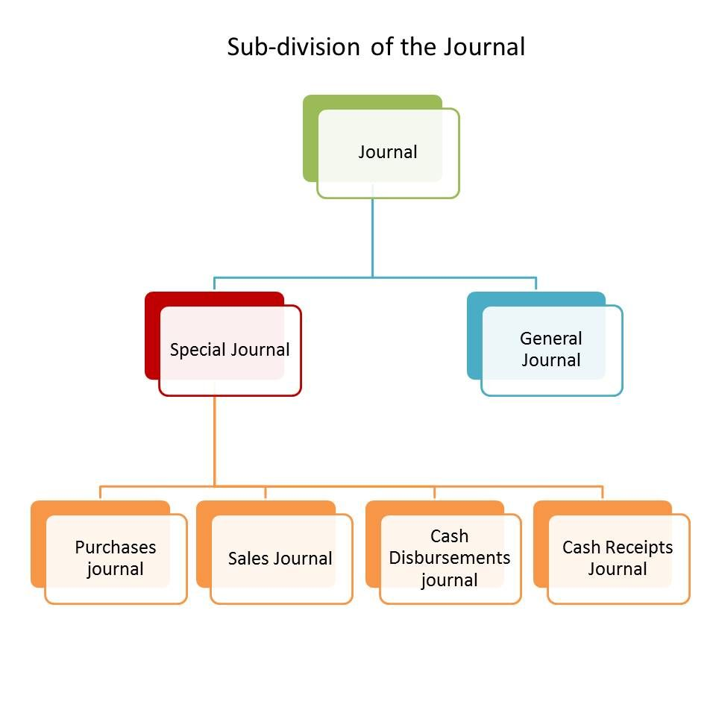
Types of Journal

Slide 95
Types of Journal
General Journal: This is the primary journal where transactions that do not fit into specific categories are recorded. It includes a wide variety of transactions, such as adjustments, corrections, and non-routine transactions.
Sales Journal: Used exclusively for recording credit sales of goods and services. Cash sales are not recorded here but in the cash receipts journal.
Purchases Journal: Dedicated to recording credit purchases, including both inventory and non-inventory items. Cash purchases are recorded in the cash disbursements journal.
Cash Receipts Journal: This journal tracks all cash inflows, including cash sales, cash received from debtors, and other cash receipts.

Slide 96
Types of Journal
Cash Disbursements Journal (or Cash Payments Journal): Used for recording all cash payments, such as payments to suppliers, salary payments, and other cash outflows.
Sales Returns and Allowances Journal: For recording returns of goods sold on credit or allowances given to customers.
Purchases Returns and Allowances Journal: For recording returns of goods purchased on credit or allowances received from suppliers.

Slide 97
Journalizing Process
Journalizing Process
The process of recording transactions in the journal is called Journalizing. The transactions are recorded in the journal in the manner of their occurrence along with a suitable explanation, called ‘Narration‘ which supports the entry.
The steps involved in the process of Journalizing are as under:
Identification of Accounts: The first and foremost step in any given transaction is to identify the accounts which are being affected with it.
Recognition of Account type: Once the accounts are identified, the type of account is ascertained, i.e. whether it is a personal account, real account or nominal account.

Slide 98
Journalizing Process
Applying the golden rules of accounting: The rules of debit and credit, i.e. the golden rules of accounting are to be applied to the accounts which are affected by the transactions.
Note: The debit and credit sides of the journal must be equal. There are some transactions in which you will find there are more than one debit for a single credit, more than one credit for a single debit or multiple debits and credits for an entry. Such entries are called as a compound journal entry. Nevertheless, the aggregate amount of debit and credit in an entry must tally.

Slide 99
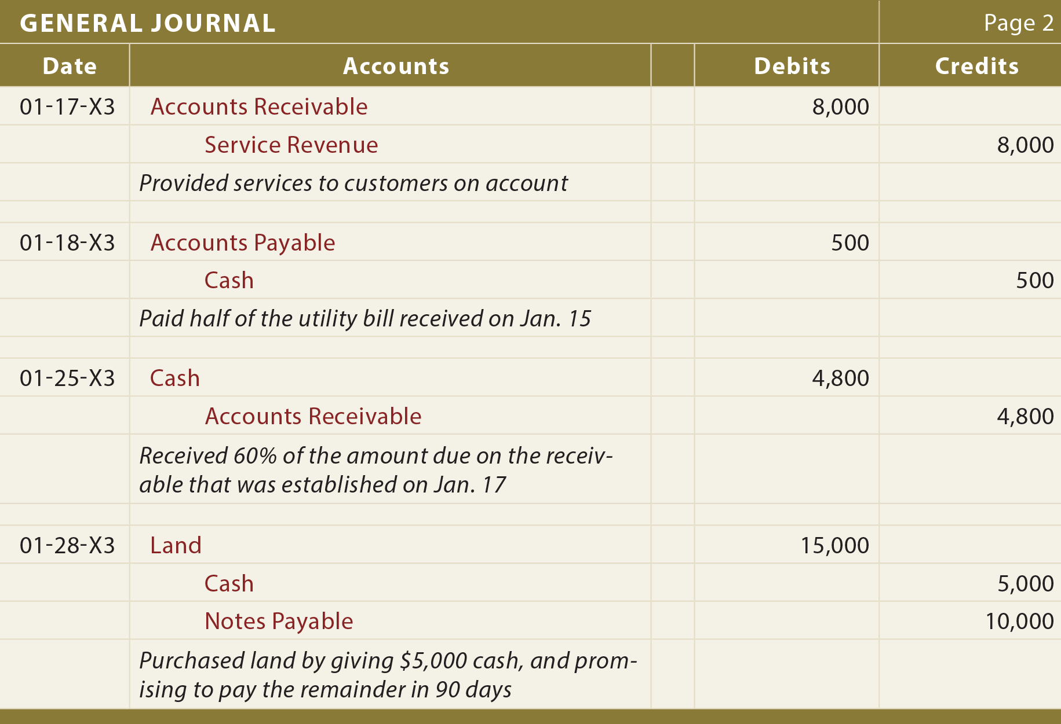
Format of Journal

Slide 100
Description of elements of journal
Date: In this column, we mention the date of the transaction along with the month in which the transaction took place. The year is indicated at the top only once and not repeated with every date.
Particulars: This column indicates the accounts which are affected, i.e. debited or credited, by the transaction. In the very first line, we write the account which is debited and then in the extreme right of the same line and column we write Dr. which indicates Debit
Voucher Number: In this column, we enter the number written on the voucher of the concerned transaction.
L.F. or Ledger Folio: As we know that transactions entered in the journal are then taken to the Ledger, in their respective accounts.

Slide 101
Summary
We have covered the following topics in this lecture:
Accounting
Forms of accounting
Nature of accounts
Rules of Accounting
Accounting cycle
Journalizing process

Slide 102
Session Learning Objectives
Students will be able to know the following concepts:
Numerical Problems-1
Numerical Problems-2
Ledger
Format of Ledger
Ledger Posting

Slide 103
Problem 1: Journalizing Transactions
Scenario: On April 1, 2023, Sarah's Design Studio, a freelance graphic design business, starts with an initial investment of $5,000 cash from Sarah. Throughout April, the studio incurs $300 in advertising expenses on credit and earns $2,000 from clients for design services rendered, receiving $1,500 in cash and $500 on account. On April 30, Sarah withdraws $600 from the business for personal use.
Task: Record the journal entries for Sarah's Design Studio for April 2023.

Slide 104
Solution
Initial Investment:
Debit: Cash $5,000
Credit: Sarah's Capital $5,000
Explanation: To record Sarah’s initial investment.
Advertising Expenses Incurred on Credit:
Debit: Advertising Expense $300
Credit: Accounts Payable $300
Explanation: To record advertising expenses incurred on credit.
Earnings from Clients for Design Services:
Debit: Cash $1,500
Debit: Accounts Receivable $500
Credit: Service Revenue $2,000
Explanation: Record revenue earned from design services, partially received in cash and partially on account.
Withdrawal by Sarah:
Debit: Sarah's Drawings $600
Credit: Cash $600
Explanation: Record Sarah's withdrawal from the business for personal use.

Slide 105
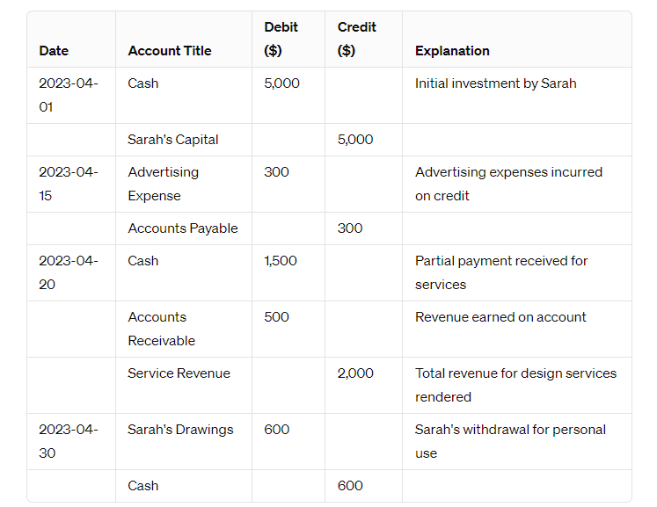
Solution

Slide 106
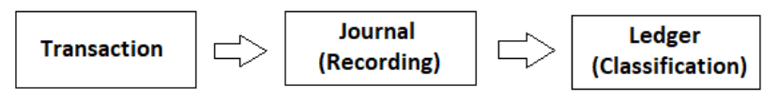
Ledger
Ledger
Ledger implies the principal books of accounts, wherein all accounts, i.e. personal, real and nominal are maintained. After recording the transactions in the journal, the transactions are classified and grouped as per their title, and so all the transactions of similar type into are put in a particular account.
Format of Ledger
A ledger account is T-shaped, having two sides, wherein the left part of the account represents the debit side, whereas the right part of the account, is the credit one. Both the sides consist of four columns, as you can see in the specimen below.

Slide 107
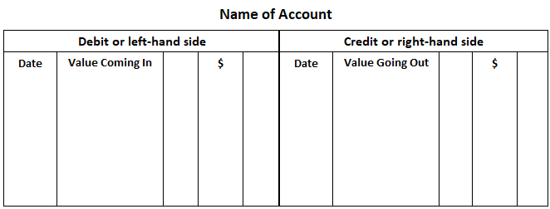
Format of Ledger
It is important to check the accuracy of entries made in ledger accounts at regular intervals as failing to debit a customer's account for goods bought on credit, for instance, may result in no payment reminder being sent.

Slide 108
The Ledger: The Second Phase of Accounting
The ledger is the principal book of accounts in which transactions of a similar nature relating to a particular person or thing are recorded in classified form.
Also known as the general ledger, the ledger is a book in which all accounts relating to a business enterprise are kept.
In other words, it is the collection of all business enterprise accounts. The accounts kept in the ledger are sometimes termed ledger accounts.
One account usually occupies one page in the ledger. However, if the account is large, it may extend to two or more pages.
All entries recorded in the general journal must be transferred to ledger accounts.
The ledger may be in a bounded form or loose-leaf form. It is the master reference book of the accounting system.
It provides a permanent and classified record of every element in the business operation.
Due to these features, the ledger is sometimes called the king of all the books of accounts.

Slide 109
Posting of entries into Ledger
The accounts are balanced at each month’s or financial year’s end. And to do so both the sides are totalled first and then the difference between the two sides is ascertained. This difference is called the balance, which is added to the side which falls short. When the credit side is greater than the debit side, it is called a credit balance which is indicated as ‘To balance c/d’.On the other hand, when the debit side is in excess of the credit side it is termed as debit balance, which is indicated as ‘By balance c/d’.
Subdivision of Ledger
The ledger is subdivided into two major categories:

Slide 110
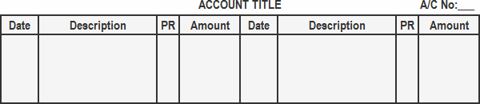
Types of Ledger
There are two popular formats for ledger accounts:
Standard format (or T-shaped format) of ledger account
In the standard format of a ledger account, the page is divided into two equal halves. The left-hand side is known as the debit side and the right-hand side is the credit side.
As it takes the shape of the capital letter “T”, it is also known as the T-shaped format.
The debit side is used to record debit entries and the credit side is used to record credit entries.
The title of the account is written in the center at the top of the page. The account number is written in the extreme right-hand corner.

Slide 111
Standard format Example
Record the following transactions in the general journal and post them to the ledger accounts:
Jan. 01: Mr. A started a business with cash of $45,000
Jan. 04: Purchased merchandise for cash amounting to $4,500
Jan. 10: Sold merchandise to Mr. John for $1,450
Jan. 31: Cash received from Mr. John amounting to $1,400 with a discount of $50

Slide 112
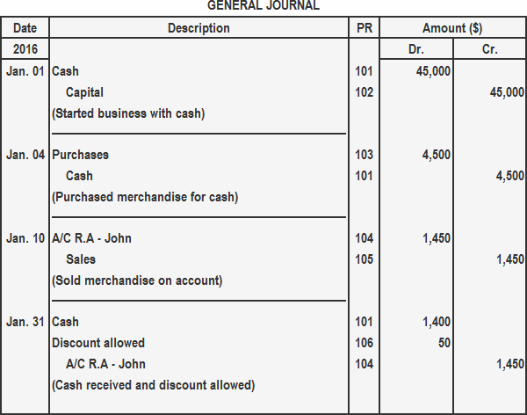
Standard format Example

Slide 113
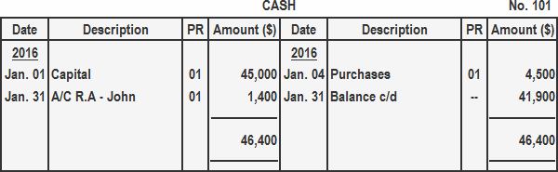
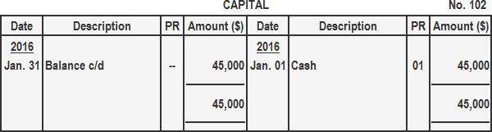
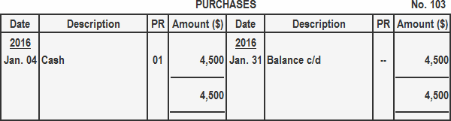
Standard format Example

Slide 114
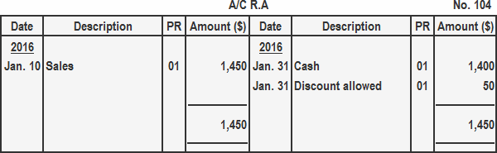
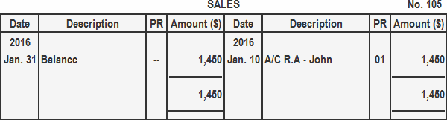
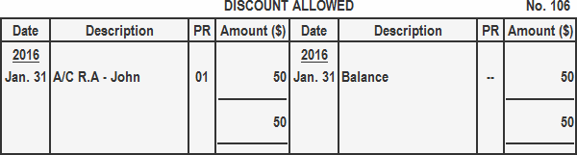
Standard format Example

Slide 115
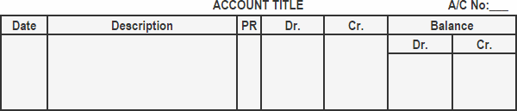
Types of Ledger
Self-balancing Format
In the standard format of a ledger account, the balance is not stated after each transaction.
In organisations where account balances are required after each transaction, a ledger account’s self-balancing or running balance format is used.
The main advantage of this ledger account format is that it shows the current balance at a glance.
Banks and other financial institutions are examples of business organisations that use self-balancing ledger accounts.

Slide 116
Self-balancing Format Example
Journalize the following transactions and post them to the ledger accounts. Use the self-balancing/running balance ledger account format.
Mar. 01: Started a business with $40,000 cash
Mar. 04: Purchased machinery for $4,000 cash
Mar. 08: Purchased merchandise for $1,400 on account from S Brothers
Mar. 12: Sold merchandise to a customer for $700 cash
Mar. 15: Paid $1,380 cash to S Brothers and received a cash discount of $20

Slide 117
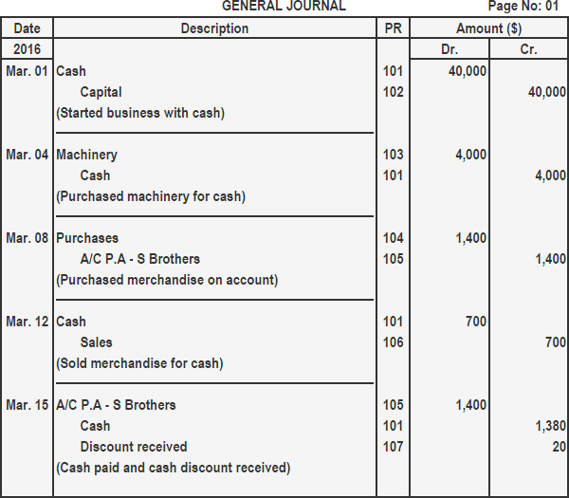
Self-balancing Format Example

Slide 118
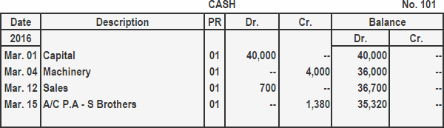
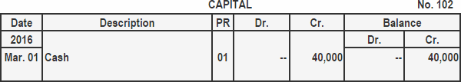
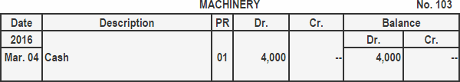
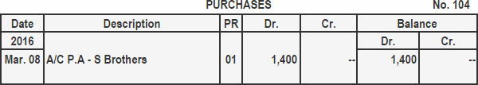
Self-balancing Format Example

Slide 119
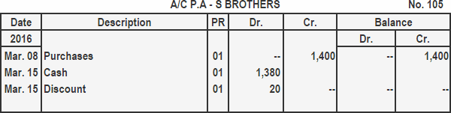
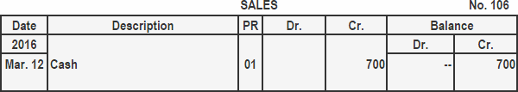
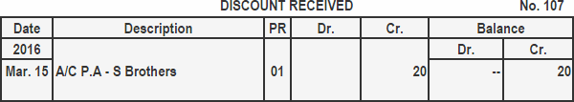
Self-balancing Format Example

Slide 120
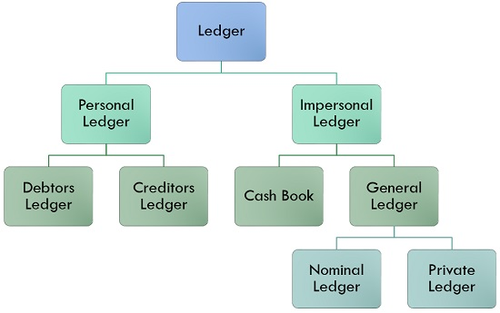
Types of Ledger

Slide 121
Types of Ledger
1. Personal Ledger: Personal Ledger implies the ledger that records details of every transaction about the persons, concerned with the accounting unit
Debtors Ledger: Debtors are the persons to whom goods are sold. So, it includes the accounts of individual trade debtors of the entity covered in this category.
Creditors Ledger: Creditors are the persons or firms from whom we purchase the goods. So, it encompasses the accounts of individual trade creditors of the business enterprise.
2. Impersonal Ledger: The ledger records all the entries relating to assets, liabilities, incomes and Expenses. It is divided into two categories:
Cash Book: This book contains all the cash and bank transactions.
General Ledger: The ledger in which all the entries with respect to natural and nominal accounts are recorded. It is known as the general ledger. It is further divided into two categories:
Nominal Ledger: This category covers ledger accounts relating to incomes such as Sales, Rent received, Commission earned, Interest received, etc., and expenses such as Wages, Salaries, Purchases, Electricity, Rent Paid, Commission Paid, etc.
Private Ledger: The ledger in which entries concerned with assets and liabilities are entered is called Private Ledger.

Slide 122
Trial Balance
A trial balance is a report that lists the balances of all general ledger accounts of a company at a certain point in time. The accounts reflected on a trial balance are related to all major accounting items, including assets, liabilities, equity, revenues, expenses, gains, and losses. It is primarily used to identify the balance of debits and credits entries from the transactions recorded in the general ledger at a certain point in time.

Slide 123
What Does a Trial Balance Include?
A trial balance includes a list of all general ledger account totals. Each account should include an account number, description of the account, and its final debit/credit balance. In addition, it should state the final date of the accounting period for which the report is created. The main difference from the general ledger is that the general ledger shows all of the transactions by account, whereas the trial balance only shows the account totals, not each separate transaction.
Finally, if some adjusting entries were entered, it must be reflected on a trial balance. In this case, it should show the figures before the adjustment, the adjusting entry, and the balances after the adjustment.

Slide 124
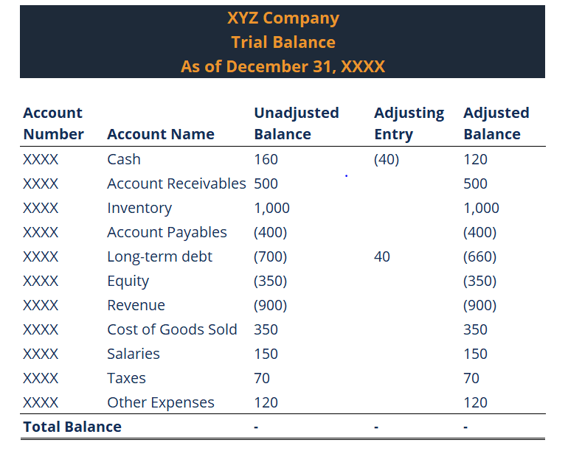
What Does a Trial Balance Include?

Slide 125
Undetectable Errors in a Trial Balance
A trial balance can trace the mathematical inaccuracy of the general ledger. However, there are several errors that this report cannot detect:
Error of omission: The transaction was not entered into the system.
Error of original entry: The double-entry transaction includes the wrong amounts on both sides.
Error of reversal: When a double-entry transaction was entered with the correct amounts, the account to be debited is credited, and the account to be credited is debited.
Principle error: The entered transaction violates the fundamental principles of accounting. For example, the amount entered was correct, and the appropriate side was chosen, but the type of account was wrong (e.g., expense account instead of liability account).
Commission error: The transaction amount is correct, but the account debited or credited is wrong. It is similar to the principle error described above, but commission error is usually a result of oversight, while principle error is a consequence of a lack of knowledge of accounting principles.

Slide 126
Session Learning Objectives
Students will be able to know the following concepts:
Trial Balance
Purpose of Trial Balance
Methods of Preparation of Trial Balance
Format of Trial Balance

Slide 127
Depreciation
Depreciation is an accounting method used to allocate the cost of a tangible or physical asset over its useful life. It represents the wear and tear, deterioration, or obsolescence of the asset. Depreciation is a way for businesses to spread the expense of an asset over the period it is used, rather than accounting for the entire cost in the year of purchase. This aligns with the matching principle in accounting, which states that expenses should be matched with the revenues they help generate.
Example:
Let's say a company purchases a machine for $100,000, with a salvage value of $10,000 and a useful life of 9 years. Using the straight-line method, the annual depreciation expense would be calculated as follows:
Cost of the Machine: $100,000 Less: Salvage Value: $10,000 Depreciable Amount: $90,000 Useful Life: 9 years Annual Depreciation Expense: $90,000 / 9 = $10,000 per year
So, each year, the company will record a depreciation expense of $10,000, reflecting the usage and aging of the machine.
Depreciation is essential in providing a realistic picture of the asset's value and the company's financial performance, ensuring that financial statements accurately reflect the company's assets and profitability.

Slide 128
Depreciation Objectives
To calculate proper profits.
To show the asset at its reasonable value.
To maintain the original monetary investment of the asset intact.
Provision of depreciation results in some incidental advantages also.
To provide for replacement of an asset.
Depreciation is permitted to be deducted from profits for tax purposes.

Slide 129
Key Points about Depreciation:
Non-Cash Expense: Depreciation is a non-cash expense, meaning it does not involve an actual outflow of cash. It's an accounting entry that reduces the value of assets on the balance sheet and charges a portion of the asset's cost to the income statement.
Types of Assets: Depreciation is applicable to fixed assets like buildings, machinery, equipment, vehicles, and furniture - assets that have a useful life exceeding one year and are used in the operation of the business.
Methods of Depreciation:
Straight-Line Method: This is the simplest and most commonly used method. It involves charging an equal amount of depreciation each year over the asset's useful life. The annual depreciation expense is calculated by dividing the cost of the asset, less its salvage value, by its estimated useful life.
Declining Balance Method: A form of accelerated depreciation where a higher expense is recorded in the early years of the asset's life, and it decreases over time. This is often used for assets that lose value more quickly in the early years.
Units of Production Method: This method ties depreciation to the usage of the asset. The depreciation expense is based on the asset's actual usage or production, making it more accurate for assets whose wear and tear depend on how much they are used.
Tax Implications: While depreciation is an accounting method, it also has tax implications. It can reduce taxable income, as the depreciation expense is deductible for tax purposes.
Impact on Financial Statements: Depreciation affects both the balance sheet and the income statement. On the balance sheet, the asset's book value is reduced by accumulated depreciation. On the income statement, depreciation is listed as an expense, reducing the net income.

Slide 130
Causes of Depreciation
Internal causes: wear and tear, disuse, maintenance, change in production, restriction of production, reduced demand, technical progress & depletion.
External causes: obsolescence and effluxion of time.

Slide 131
Factors in measurement of depreciation
The asset’s cost: The asset’s estimated salvage value. Salvage value (also called residual value) is the amount of money that the company expects to recover, less the disposal costs, on the date the asset is scrapped, sold, or traded in.
Estimated useful life of the asset: Useful life refers to the window of time that a company plans to use an asset.
Obsolescence should be considered when determining an asset’s useful life, and it will affect the calculation of depreciation.

Slide 132
Methods of recording depreciation
Straight line method or fixed instalment
Declining charge method or diminishing or WDV

Slide 133
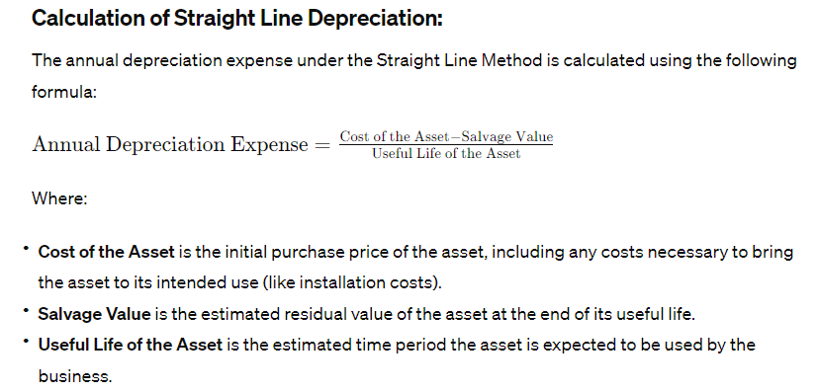
Straight Line Method
The Straight Line Method, also known as the Fixed Installment Method, is one of the most commonly used methods for calculating depreciation on fixed assets. It allocates an equal amount of depreciation to each accounting period over the asset's useful life. This method is simple to calculate and apply, making it a popular choice for businesses.

Slide 134
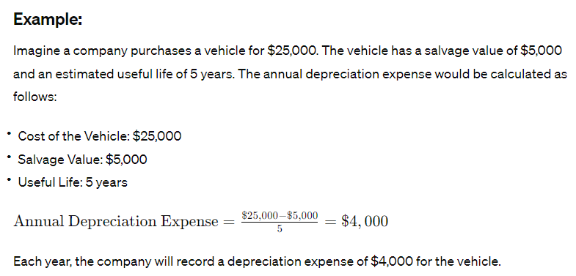
Straight Line Method

Slide 135
Advantages of Straight Line Method
Uniform Expense Amount: It charges the same amount of expense to each accounting period.
Easy to Implement: Due to its simplicity, it is easy to calculate and apply.
No Consideration of Usage: This method does not consider the actual usage or wear and tear of the asset, which might vary over its life.
Impact on Financial Statements: It results in a consistent expense amount each year, leading to a steady reduction in profits over the asset's useful life.

Slide 136
Diminishing Value Method
The Declining Balance Method, also known as the Diminishing Balance Method or Written Down Value (WDV) Method, is a common approach to calculating depreciation. This method results in higher depreciation charges in the early years of an asset's life, which gradually decrease over time. This method is based on the idea that certain assets lose their value more rapidly in their initial usage years.
According to the diminishing value method, depreciation is charged on reducing balance & a fixed rate. Depreciation, in this case, is accused over the useful life of an asset over its written-down value.
The percentage at which depreciation is charged remains fixed. However, the amount of depreciation diminishes year after year. According to the Diminishing Value Method,
D = Depreciation %
n = Useful life of the asset in years
r = residual value of the asset
c = Cost of asset

Slide 137
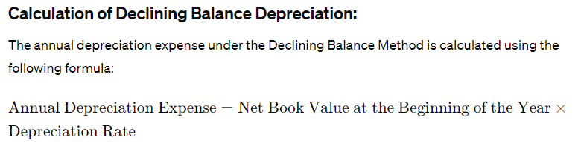
Diminishing Value Method

Slide 138
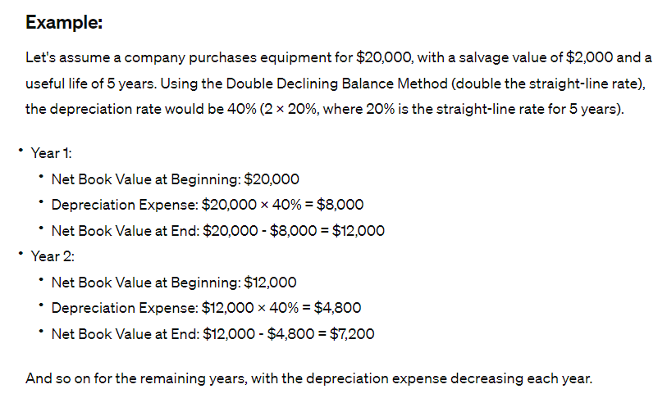
Diminishing Value Method

Slide 139
Advantages of Diminishing Value Method
More practical and easy to apply.
Decreasing charge for depreciation cancels out increasing charges for repairs.
This method is applicable for income tax purposes.

Slide 140
Video Links
https://www.investopedia.com/terms/a/accounting-principles.asp
https://www.slideshare.net/veenamadaan94/accounting-principle-30033976
https://www.youtube.com/watch?v=eDFNyoN-uPI
http://castudying.blogspot.com/2017/01/accounting-standard-pm.html
https://www.icai.org/post.html?post_id=8202

Slide 141
Daily Quiz
Define Double Entry Accounting.
Explain the objectives of Accounting.
Explain Going Concern Concept.
Explain: Realization Concept.
Define the dual aspect concept.
Define principle of historical cost.
Define modifying principle

Slide 142
MCQs
Disclosing about assets without disclosing about liabilities is against the principle of full disclosure. True/False
Under dual aspects principle, total benefits received by business should match with total benefits given. True/False
The material information to one party need not to be so for another party. True/False
The method of depreciation adopted should be disclosed to income tac authorities. True/False
Interest earn but not received within an accounting period is called_________.

Slide 143
Weekly Assignment
What are the basic principles of accountancy?
What is double-entry bookkeeping?
Explain the different types of accounting principles.
How do investors and vendors use accounting information?
To make the account comparable, we need to follow one convention, name the convention, and explain the same.

Slide 144
Old Question Papers
Explain the different types of accounting principles. (AKTU 2018-19)
Explain the process involved in accounting. (AKTU 2018-19)
Explain depreciation in brief with its types. (AKTU 2017-18)
Define accounting its objective and limitation. (AKTU 2019-20)
“Accounting is based on concepts” do you agree with the above statement? Kindly explain any 5 concepts in detail with example. (AKTU 2019-20)

Slide 145
Expected Questions for University Exam
What are the Accounting standards? How Indian Accounting standards and International Accounting Standards are different?
What are different types of Accounts? Explain various principles of accounting used for these accounts.
Give two basic purpose of accounting equation.
Write short notes on accounting convention.
Why is depreciation charged while preparing profit and loss account?

Slide 146
Summary
Accounting is a process of identifying, measuring, recording the transaction and events in a systematic manner in the book of accounts, classifying and finally summarizing in a useful manner to the user of accounting information.
Accounting principles are the rules of action adopted by accountant universally while recording accounting transaction.
Accounting conventions are those custom and tradition which guide the accountant while preparing the financial statements.

Slide 147
References
Text Books :
Maheshwari S.N & Maheshwari S K – A textbook of Accounting for Management (Vikas, 10th Edition)
Essentials of Financial Accounting (based on IFRS), Bhattacharya (PHI,3rd Ed)
Khan and Jain - Financial Management (Tata McGraw Hill, 7th Ed.)
Reference Books
Narayanswami - Financial Accounting: A Managerial Perspective (PHI,5th Ed)
DhaneshkKhatri- Financial Accounting (TMH,2015)

Slide 148
Thank You………………………………….
All The Best For Your Exams……………………………………

